Slide 2
JSON Functions - Exchanging Complex Data Between Power Apps and Power Automate
Clavin Fernandes and Yash Kamdar

Slide 3




Clavin Fernandes
Technical Consultant at Rapid Circle and Technical Support Manager at Muhimbi Ltd
Clavin Fernandes is the support manager for Muhimbi Ltd - Home of the PDF Converter for SharePoint / Office 365/ Power Platform.
He supports over 1,000 high level Enterprise customers with all kinds of challenges related to PDF Conversion in combination with SharePoint On-Premise, Office 365, Azure, Nintex workflow, K2 and Power Platform, mostly with no code solution that Empower SharePoint and Business users.
He likes to stay up to date and in recent years has focused a lot on Microsoft Power Automate (Flow) and Power Apps.
Clavin loves to share his knowledge on his personal blog (https://clavinfernandes.wordpress.com/) where he shares his knowledge in the hopes that it will help other Power Users.
cfernandes@muhimbi.com
https://www.linkedin.com/in/clavin-fernandes-38a30862/
https://twitter.com/clavinfernandes
https://www.facebook.com/clavin.fernandes.90

Slide 4

Yash Kamdar
Cloud Infrastructure Consultant at Rapid Circle and Muhimbi Consultant for Muhimbi Ltd
Yash Kamdar works as a Cloud Infrastructure Consultant at Rapid Circle and Muhimbi Consultant for Muhimbi Ltd - Home of the PDF Converter for SharePoint/Office 365/Power Platform.
His major responsibilities include designing solutions for end customers of Muhimbi using Flow, Power Apps, Nintex workflows, SharePoint designer workflows in both the SharePoint On premise as well as Online platforms.
He started his career as a SharePoint Administrator with different focuses ranging from architecting and deploying full hybrid environments to governance and search, as well as migration-specific projects.
He is a Microsoft Certified Professional holding a certification for 70331 (Managing SharePoint server 2016).
His free time is spent writing blogs on AWS Devops, Containerization, Docker and troubleshooting SharePoint infrastructure issues.
ykamdar@muhimbi.com
https://www.linkedin.com/in/yash-kamdar-225494b2/
https://twitter.com/yashkamdar391
https://www.facebook.com/ykamdar3

Slide 5
Session Overview
In this session, we will leverage the power of JSON Functions and exchange complex data from Power Apps
to Power Automate.
We will pass this data from the Camera Control (photo), Pen Input(ink control), and Microphone, as well we will
Export an entire Power Apps gallery to Power Automate and enrich it with HTML, then convert it to PDF.
Benefits of Attending this Session -
Create a PowerApps form with complex controls.
Understanding JSON Functions.
Advantages of JSON Functions.
PDF Convert, Merge, and Watermark files using PowerApps and Power Automate.
Notes:
The JSON function returns the JavaScript Object Notation (JSON) representation of a data structure as text so that it's suitable for storing or transmitting across a network

Slide 6
A Deep Dive into The JSON Function in Power Apps

Slide 7

Introduction to JSON function
JSON functions were introduced in and around June 2019.
The JSON function returns the JavaScript Object Notation.
It may sound complicated, but it is indeed simple to use.
{
"processed_file_content": "string",
"base_file_name": "string",
"result_code": "Success",
"result_details": "string"
}

Slide 8
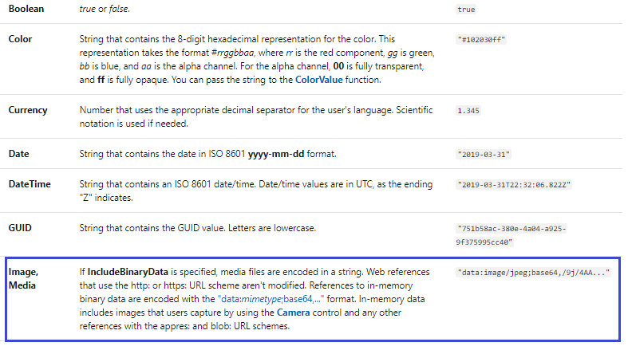
Data Types Supported by JSON Functions

Slide 9
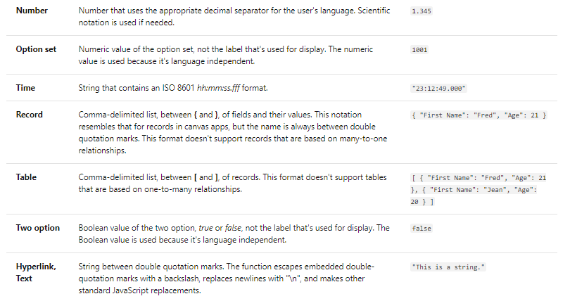
Some More Data Types

Slide 10
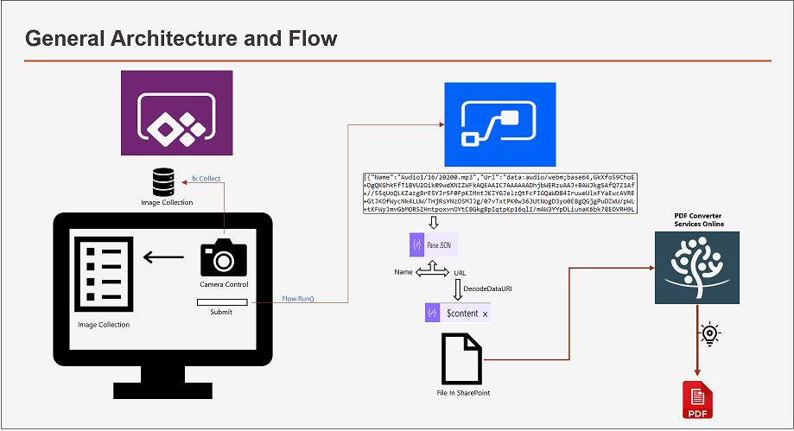
General Architecture and Flow
Notes:
To understand how JSON works let have a quick look at the diagram.
For this demo we let consider we launch our PowerApp on PC, click a picture and you want to save it in SharePoint, how will you do it? If you look at the image you will see some text on in the center, the text is base64 bit string? So how many of you understand “base64”?
So for people do not understand base 64. Base64 is a group of binary-to-text encoding schemes that represent binary data. Hmm. We all know that files are stored as binary, however PowerApps interprets that file(Binary) as base64. So if you get the file content ”you get the file”. So once you get the file content you can pass it Power Automate and use the base64 bit and then again convert it into file.

Slide 11
Demo – Export Multiple Media Controls to PDF
Notes:
Let me quickly launch the PowerApps designer and create a canvas app.
The first media control that I would like to demonstrate is the camera control. > So no need of JSON function
The second media control would be PenInput,
The SharePoint attachment control.
Then do a simple flow to save the file.

Slide 12
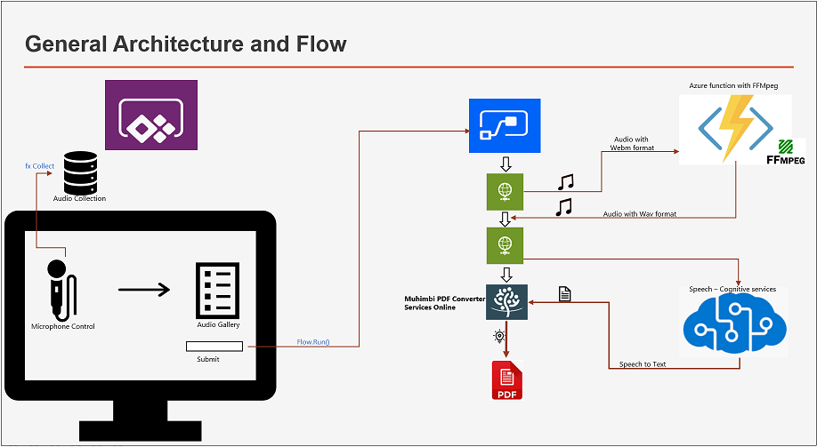
General Architecture and Flow

Slide 13
Enough Talking! Demo on Power Apps Microphone Media Type!

Slide 14
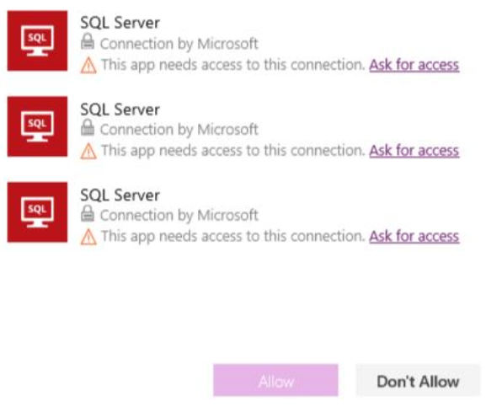
Decoupling the Flow
Vote for this Idea: https://powerusers.microsoft.com/t5/Power-Apps-Ideas/Sharing-Flow-and-connections/idi-p/46925

Slide 15

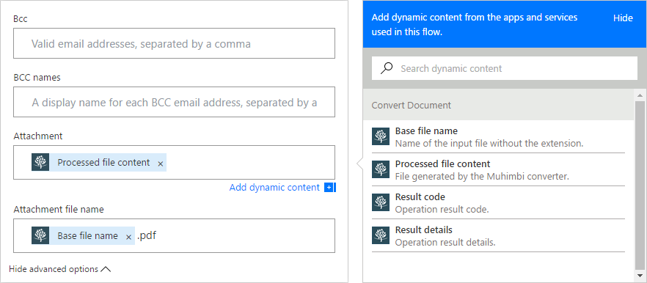
Muhimbi PDF Converter Services Online – Core Concepts Used by The PDF Converter

Slide 16
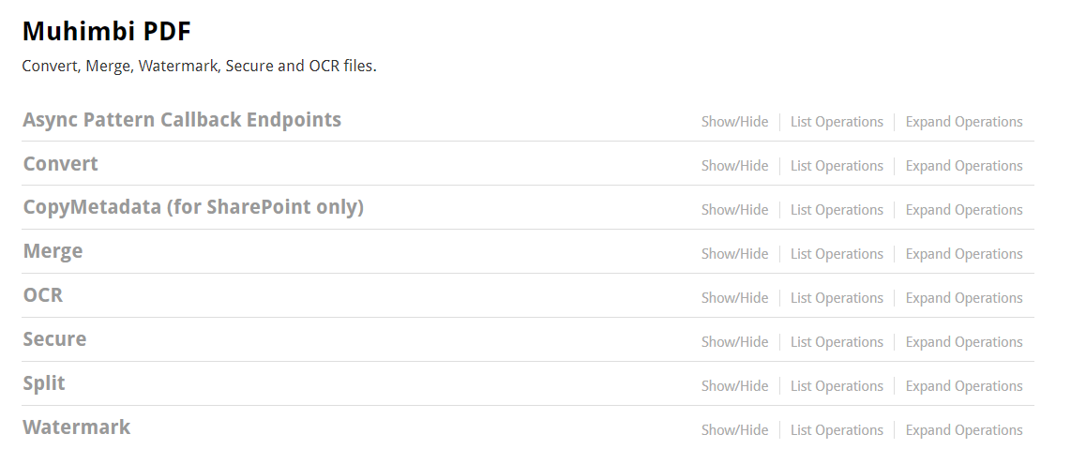
Don’t want to Decouple the Flow? Then use the Muhimbi REST API!

Slide 17

Thank you – Connect with us
support@muhimbi.com
https://www.linkedin.com/company/muhimbi-ltd
https://twitter.com/muhimbi
https://www.muhimbi.com

Slide 18

Enjoy the Bootcamp

Slide 19
Call to action
Start a Power Platform learning path at https://docs.microsoft.com/en-us/learn/powerplatform/
Join Office 365 developer program https://dev.office.com/devprogram to leverage all resources for Office 365 development learning
Build applications on Power platform
Attend local community events to continue learning on Power Platform development

